Slide 1

Chapter 3: Gamification

Slide 2
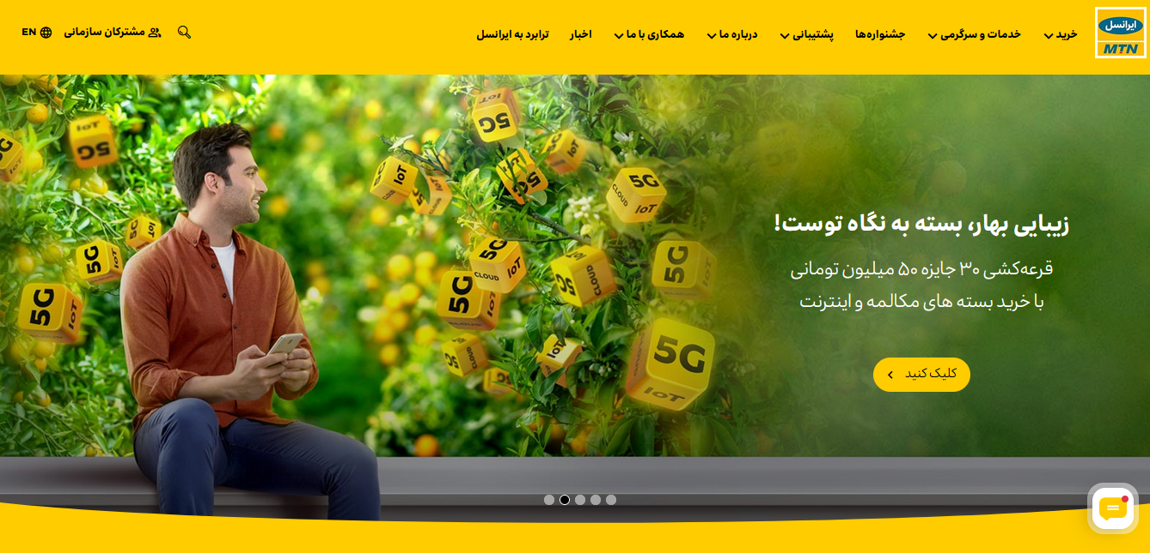


Slide 3
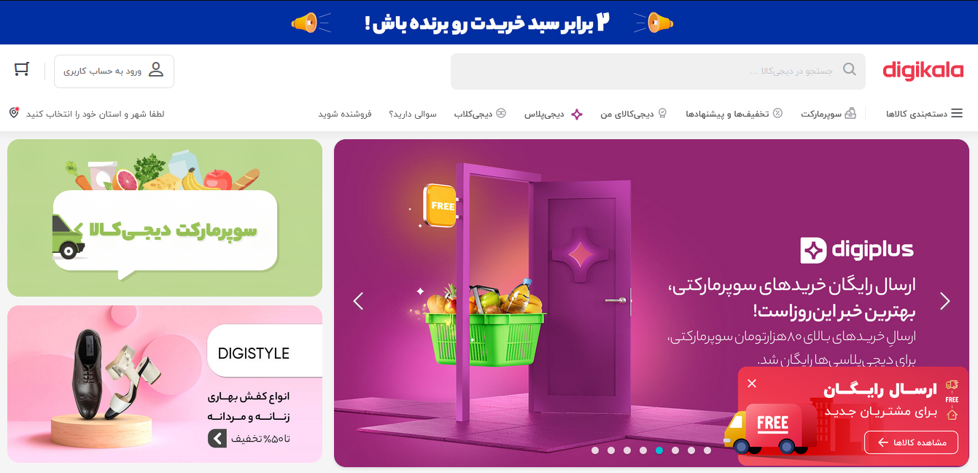

Slide 4
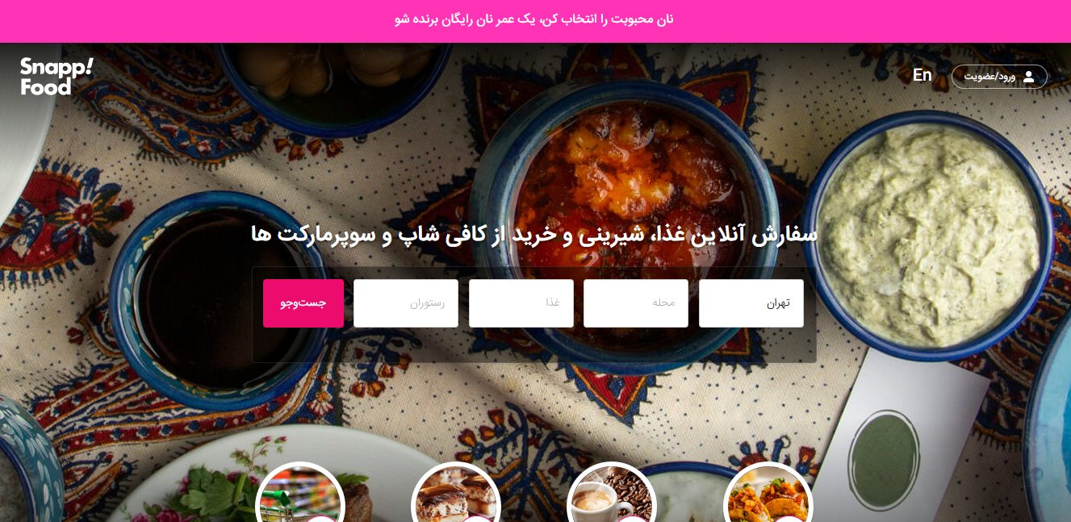
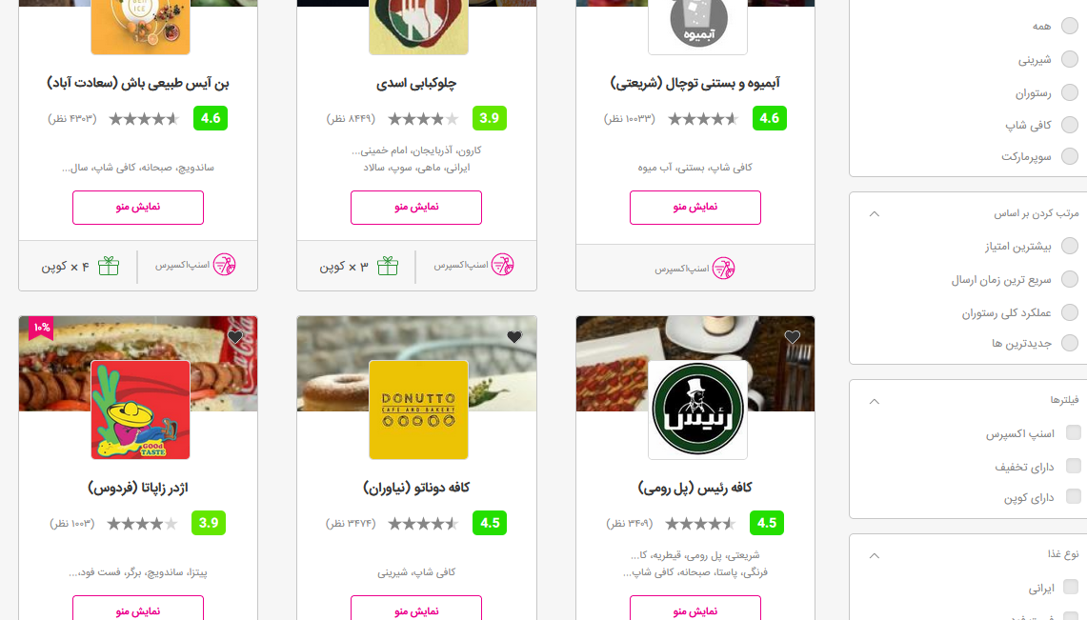

Slide 5
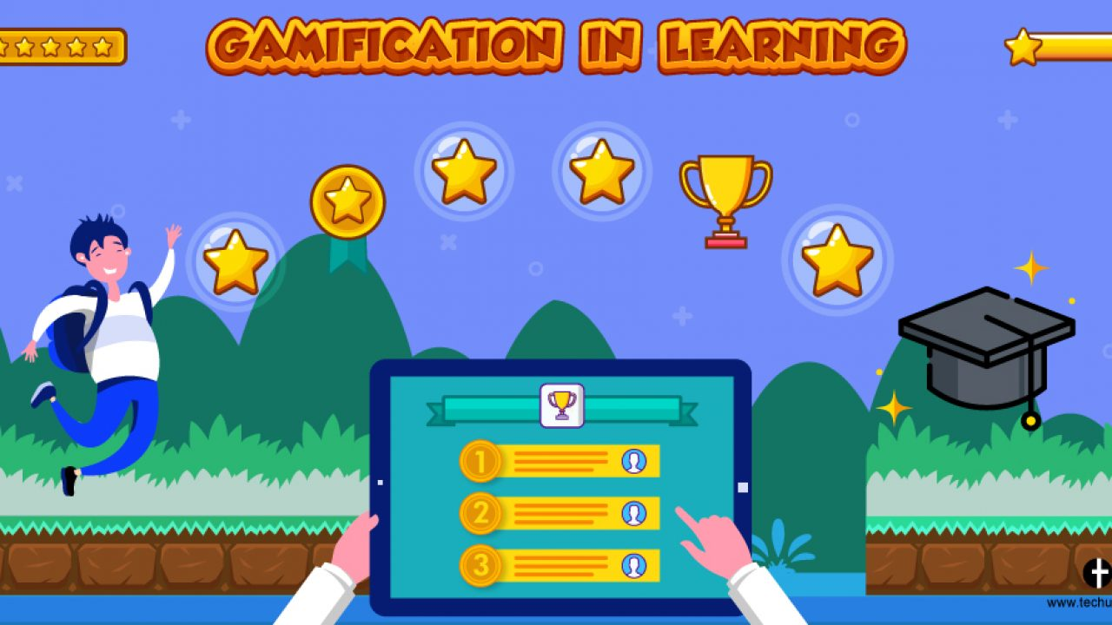

Slide 6
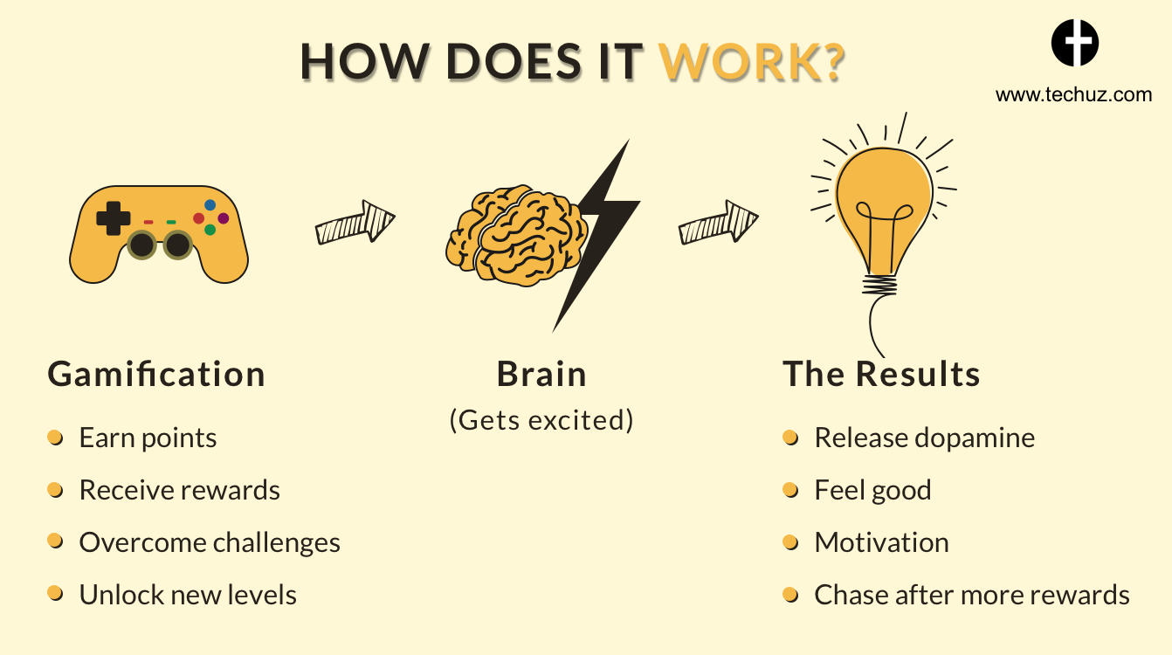

Slide 7


Game or Gamification?

Slide 8
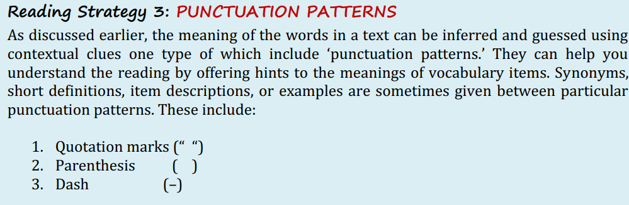

Slide 9
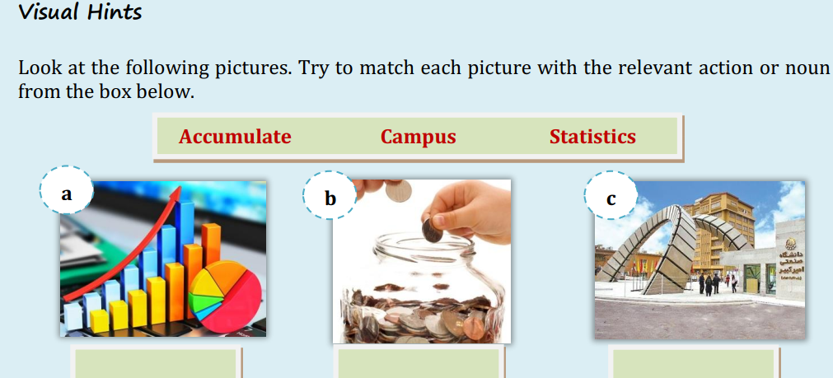

Slide 10

Gamification
The increasing popularity of games and the use of them in business and education are not at all surprising. Games are an important part of our life, and everyone plays them; whether it is with a console or mobile, or in the offline world.
The concept of gamification and its techniques in non-gaming environments is a fast emerging practice in business. The use of gamification tools and methods has also the potential to benefit educators and project managers from all industries because of their fundamental potential to shape and influence customer/user behavior.

Slide 11


Game or Gamification?
Gamification stems from computer games industry and refers to the use of game elements outside games in order to engage users and solve problems. A full game is not Gamification. Gamification does not offer a whole gaming experience, but some game elements are used.
Within the past decade, a growing number of organizations have been using gaming techniques and game-style rewards in order to motivate employees and customers. This growing popularity of gamification has been facilitated by the increased availability of appropriate technology such as smartphones and tablets, which can support a gamification environment. The main benefits of gamification include: increased engagement, higher motivation levels, increased interaction with the user (customer or employee), and greater loyalty.

Slide 12

Why are People Interested in Gamification?
Software provider Bunchball has described the attraction of gamification in a very interesting way: two people playing monopoly every day for a week would get bored very quickly, but if you add in another element – statistics – it starts to take on another dimension. How many times each person won, which properties were most profitable, how much money each player accumulated; all these elements add another level to the game. The statistics become the game and people want to outplay each other. It is the excitement created by the collection of a number of statistics, and the use of those statistics, that can encourage people to do tasks they would ordinarily consider uninteresting or repetitive. It is this use that has created a high level of interest within business and education worlds.

Slide 13
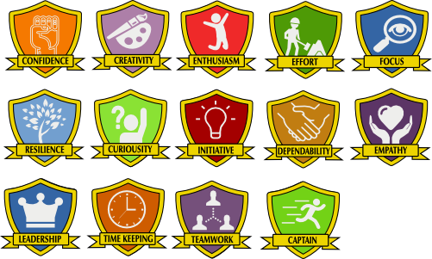
There are four main areas under gamification. The understanding and correct use of these four areas together produce an environment in which engagement, loyalty, and motivation will grow. The four areas are:
Sample gamification badges in education

Slide 14

Points: something for ‘players’ to earn
Rewards: something for ‘players’ to spend their earned points on
Badges: something to show others the success ‘players’ have achieved
Leader boards: a method of gaining real-time feedback which is visible to everyone.

Slide 15
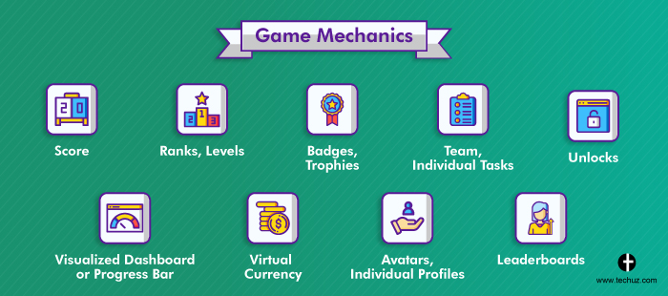

Slide 16
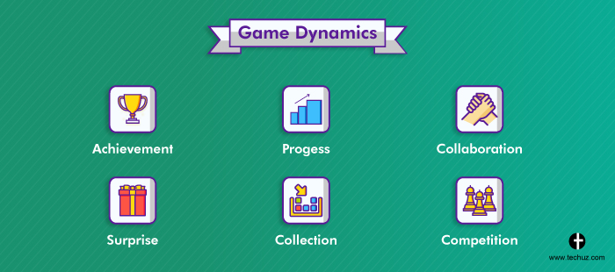

Slide 17
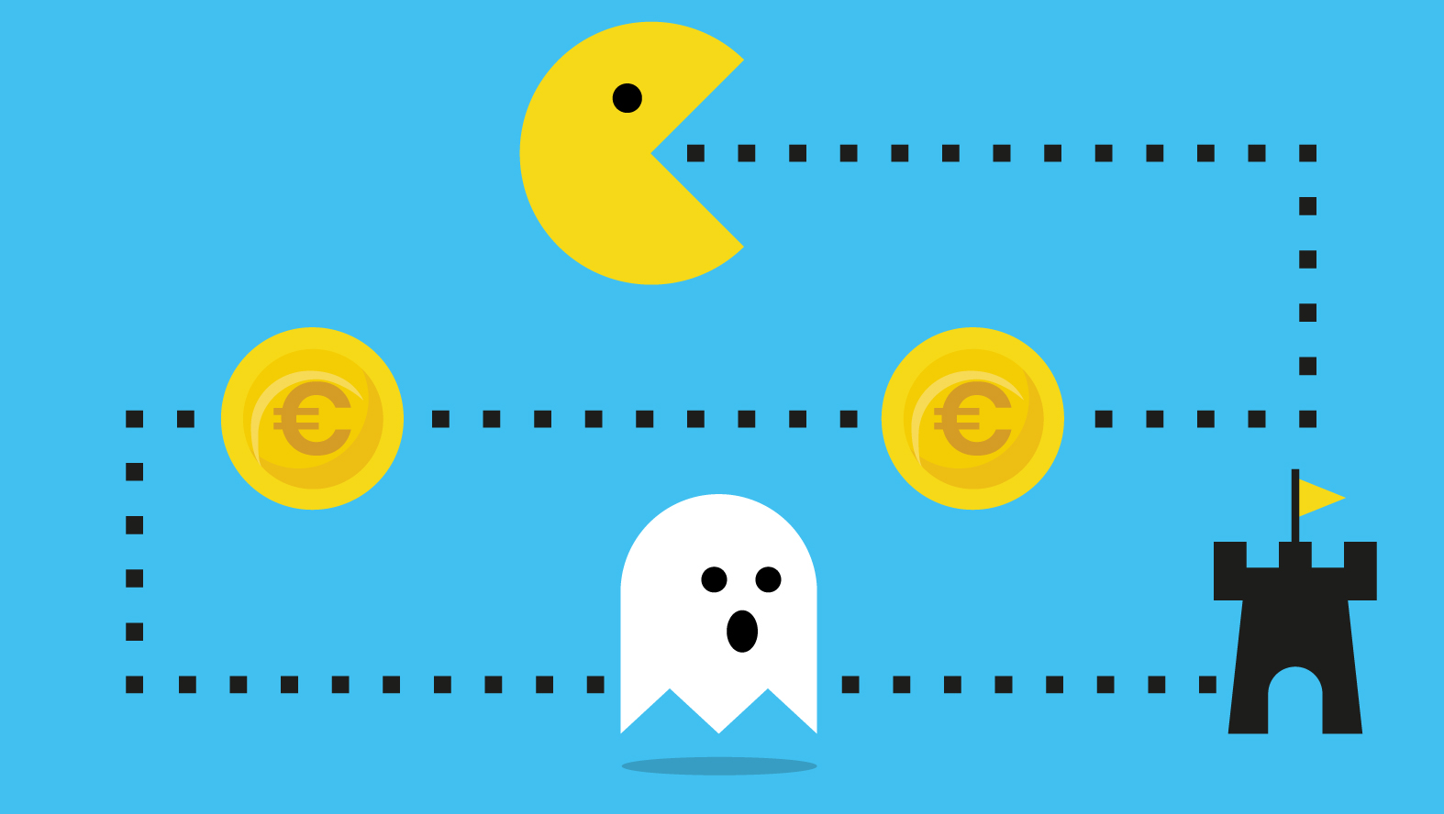
A good example of Gamification in action is the start-up PromiseUp. The app offers people the possibility to turn every promise they make into a bet e.g., plans to eat healthier or to exercise every week. By turning it into a bet with their friends, PromiseUp users can earn badges and points. The adding of game elements to a specific goal makes it a lot more fun to achieve personal goals.

Slide 18

Another interesting example of gamification is Prezi Ambassador Program. Prezi is a popular alternative to Microsoft PowerPoint. Because the service is online and offers a completely different way of presenting – zooming or turning pictures instead of regular slides – it has certain advantages compared to PowerPoint. Many people have probably used Prezi at least once.
However, because it works completely different from Microsoft PowerPoint, it is a big challenge to get the general public to use Prezi. Therefore, an important target is students, at colleges as well as universities. If they are used to work with Prezi, there is a good chance they will continue to do so when they work at a company.

Slide 19
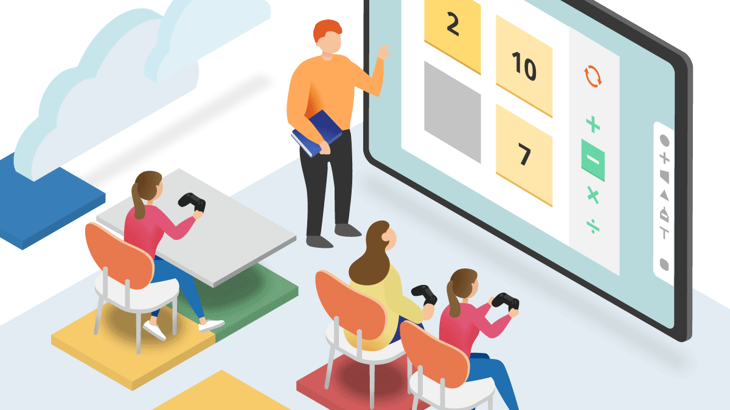
To reach this group, Prezi has started the Prezi Ambassador Program. Students from all over the world can apply for an unpaid position as Prezi Ambassador for their campus. There is only one Ambassador per campus. Ambassadors write a plan to make Prezi popular on their campus, for example by doing presentations and workshops for other students. These activities will earn them points. Moreover they compete against each other for big prizes like a trip to the Prezi offices in San Francisco and Budapest. Also, the work experience looks good on their resumes and sometimes it is possible to earn college or university credits. The key game elements Prezi uses in this program are leader boards and points. This way Prezi uses Gamification to get students from all over the world to promote the service and collect new users.

Slide 20
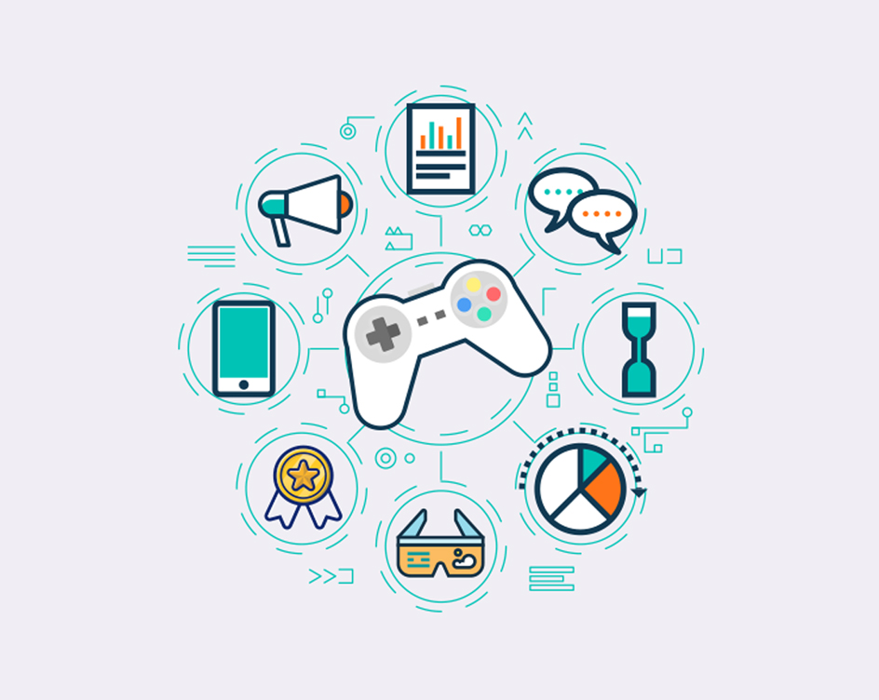
In general, players are very involved with the games they play. This involvement – or engagement – is one of the great challenges in educations. Educational institutions could learn from games in this regard. Education might be the profession which can progress most by using Gamification techniques, because of the similarities between learning and gaming. In gaming, it is all about completing levels, obtaining certain skills, and similarly education focuses on progression to the next grade, passing exams, and gaining knowledge and skills. All these similarities to games considered, it should be a piece of cake to motivate and engage students.

Slide 21
